Slide 1
CS 3186
Properties of Regular Languages
Section 4.1

Slide 2
Introduction
We have seen Regular Languages expressed by
NFA/DFA, Regular Expression, Regular Grammar.
For a regular language, there exists an NFA that accepts the same language, that is expressed by a regular expression or a regular grammar.
(Note that in Chapter 3, we indicated that how to convert an NFA with many final states to an equivalent NFA with a single final state by a new final state and adding lambda transitions to the new final state. It is easier to deal with an NFA with one initial and one final state.)

Slide 3
Operations and Closure
Closure of a set with respect to an operator: An operation is performed on operands from a set and the output result also belongs to the same set.
The set is then said to be closed under this operation. i.e., there is no new element that is added to the set because of this operation.
Consider set of natural numbers N = {0, 1, 2, 3, …}
Consider arithmetical operators (+, -, x, /) that typically operate on input operands resulting in an output.
(Binary operations with two operands: 3+2=5 2-3=-1 3x2=6 3/2=1.5
Unary operator “-” for negation: -2
Set N is closed under + and x as the output always belongs to N
Set N is not closed under – and /. (-1, -2, and 1.5 does not belong to N)
Consider set of Integers I = {…-3, -2, -1, 0, 1, 2, 3,…}
Consider arithmetical operators (+, -, x, /)
Set I is closed under +, -, and x and is not closed under /.

Slide 4


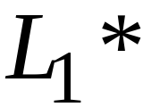
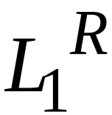



Closure of Regular Languages under Set Operations
For regular languages L1 and L2, we will prove that:
Union:
Concatenation:
Star:
Are also Regular
Languages
Reversal:
Complement:
Intersection:
Difference:

Slide 5
Regular languages are closed under the following set operations.
Union:
Concatenation:
Star:
Reversal:
Complement:
Intersection:
Difference:

Slide 6


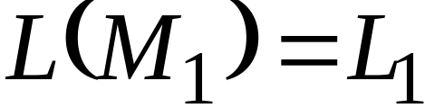
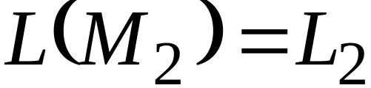


Notation
Regular language
There exists NFA M₁
Regular language
There exists NFA M₂
NFA
NFA
There exists a regular expression r₁ such that L(r₁)=L₁ (See Chapter 3)
There exists a regular expression r₂ such that L(r₂)=L₂

Slide 7


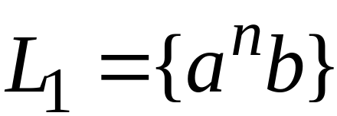

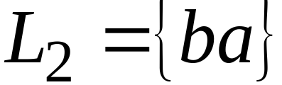
Example
r₁ = a*b
L(r₁)= L₁
r₂ = ba
L(r₂) = L₂

Slide 8


Union
We can construct NFA for as follows:
If w is accepted by M₁ or M₂, then w is accepted by the above construction. Hence, the above NFA accepts
Hence a Regular Language is closed under Union operator.

Slide 9
Union (Another proof)
If r₁ is a regular expression such that L(r₁)= L₁ and If r₂ is a regular expression such that L(r₂)= L₂
We can describe a regular expression for as simply r₁ + r₂. (See Chapter 3.1)
Hence a Regular Language is closed under Union operator.

Slide 10

Example
NFA for
Regular expression for =r1 + r2

Slide 11
Concatenation
We can construct NFA for as follows:
If x is accepted by M₁ and y is accepted by M₂, then xy is accepted by the above construction.
Hence a Regular Language is closed under Concatenation operator.

Slide 12
Concatenation (Another proof)
If r₁ is a regular expression such that L(r₁)= L₁ and If r₂ is a regular expression such that L(r₂)= L₂
We can describe a regular expression for as simply r₁ r₂. (See Chapter 3.1)
Hence a Regular Language is closed under Concatenation operator.

Slide 13
Example
NFA for
Regular expression for = r₁ r₂

Slide 14
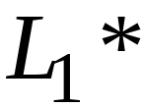
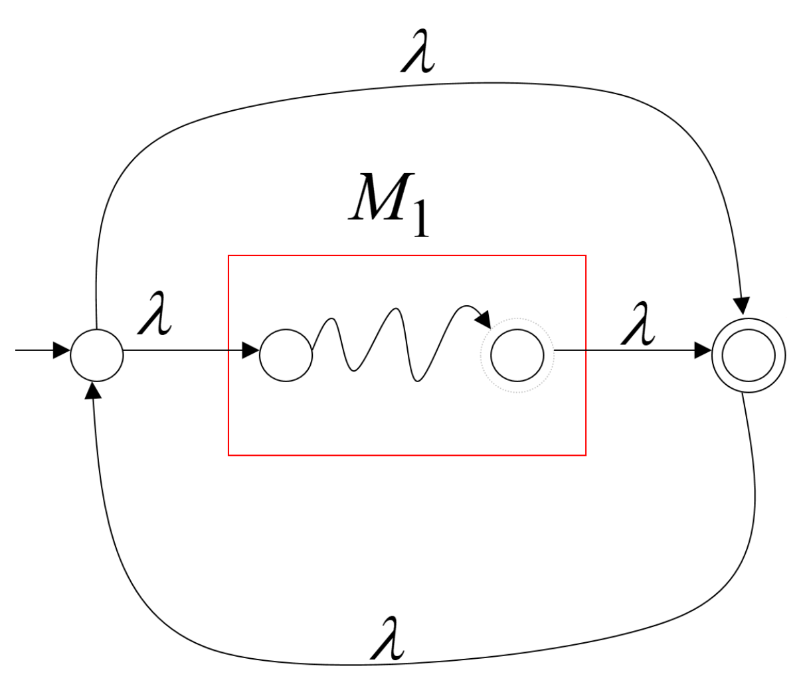
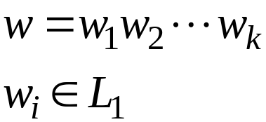
Star Operation
We can construct NFA for as follows:
Any string in w is accepted by the NFA.
Hence a Regular Language is closed under Star operator.

Slide 15
Star (Another proof)
If r₁ is a regular expression such that L(r₁)= L₁
We can describe a regular expression for as simply r₁* (See Chapter 3.1)
Hence a Regular Language is closed under Star operator.

Slide 16
Example
NFA for L₁*
Regular expression for L₁* = (a*b)*

Slide 17

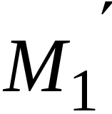
Reverse
We can construct NFA for as follows:
1. Reverse all transitions
2. Make initial state the final state and vice versa
If w is accepted by M₁, w^{R} is accepted by M₁’
Hence accepts
Hence a Regular Language is closed under Reverse operator.

Slide 18
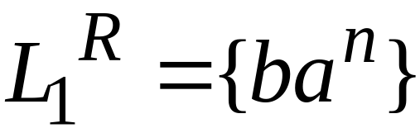
Example
(M₁’ may become an NFA even if M₁ is a DFA)

Slide 19
Complement
We can construct DFA for as follows:
1. Take the DFA, M₁,that accepts L₁
2. Make final states non-final, and vice-versa.
3. The initial state remains the same.
Then if w is accepted by M₁, w is not accepted by M₁’ and vice-versa. i.e., all the strings that are not accepted by M₁ are accepted by M₁’ Hence, M₁’ accepts
Hence a Regular Language is closed under Complement operator.

Slide 20

Complement (continued)
Note 1: This process works only on a DFA and does not work on an NFA. If we have NFA rather than DFA, we must first convert it to DFA and apply this construction to get its complement.
Note 2: Since a language is regular if and only if it is accepted by some NFA, the complement of a regular language is also regular.

Slide 21

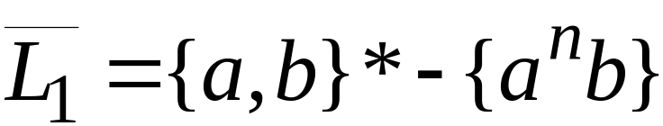
Example
Note: L₁ and L₁ are described in set notation and not as a regular expression.
The regular expression for L₁ = a*b
Can the regular expression for L₁ be described by (a+b)* - a*b?
(No! The “-” operator is not defined for regular expression)

Slide 22
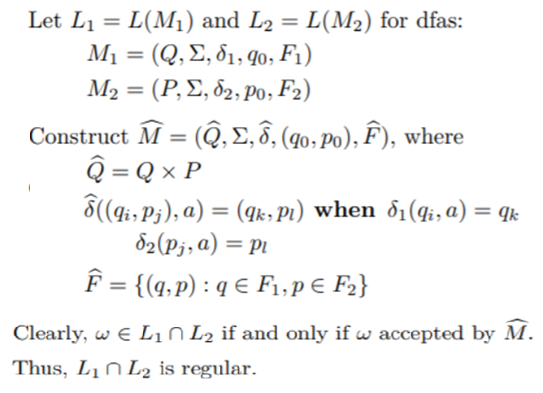
Intersection
We can construct NFA for as follows:
Hence a Regular Language is closed under Intersection operator.

Slide 23




Intersection (Another proof)
DeMorgan’s Law:
regular
regular
regular
regular
regular

Slide 24
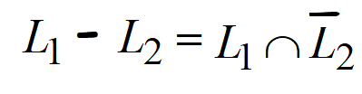
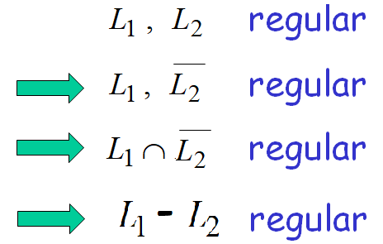

Difference
L₁ – L₂ contains all strings from L₁ but not in L₂
All strings not in L₂ = all strings in complement of L₂
i.e., L₁ – L₂ contains strings that are in L₁ and complement of L₂
i.e.,
Since,
An NFA can be constructed for
Hence a Regular Language is closed under Difference operator.

Slide 25

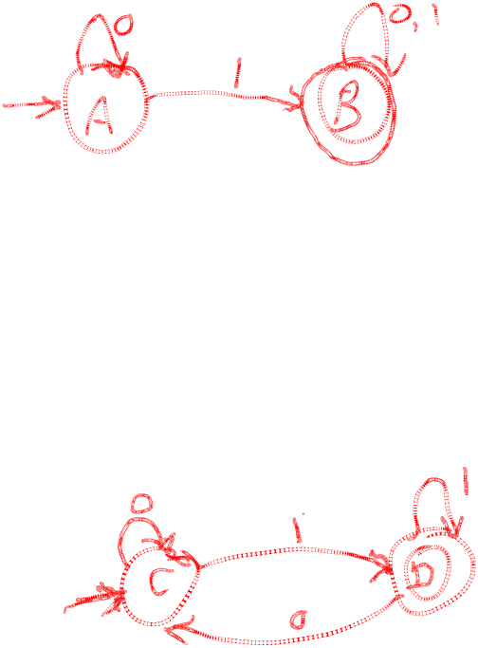
(i) Give a DFA, M₁, that accepts a Language
L₁ = {all strings that contains a 1; i.e., at least one 1}
(ii) Give a DFA, M₂, that accepts a Language
L₂ = {all strings that end with 1}
Complete Example

Slide 26
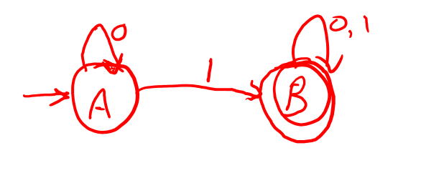






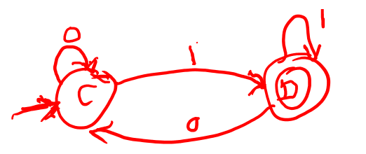
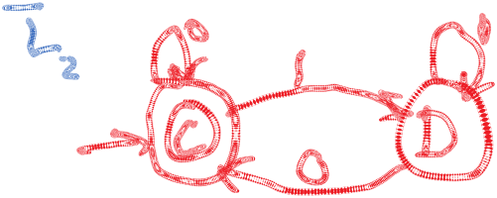
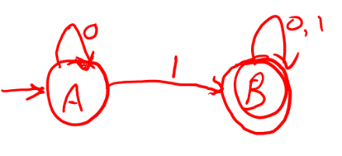








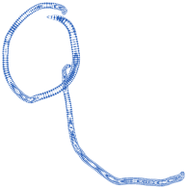
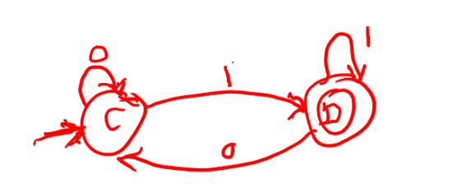




(iii) Give acceptor for Reverse of L₁
(iv) Give acceptor for complement of L₂
(v) Give acceptor for L₁ union L₂
Example (continued)

Slide 27
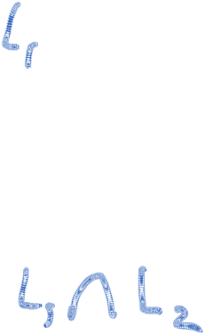

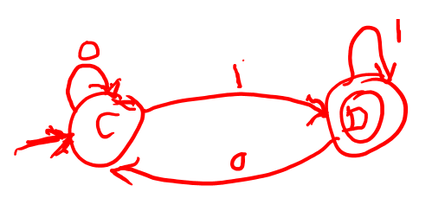
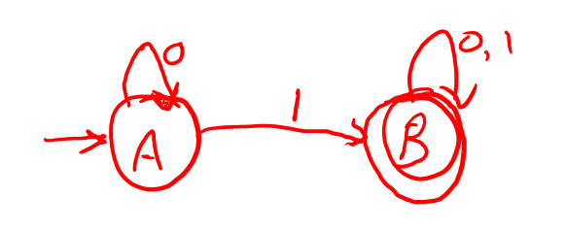










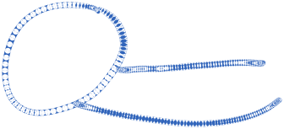



(vi) Give acceptor for L₁ intersection L₂
Example (continued)

Slide 28
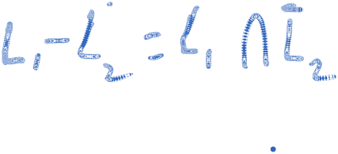
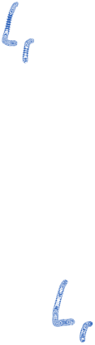














(vii) Give acceptor for L₁ - L₂
Example (continued)

Slide 29

(I) Give a DFA that accepts language L with all strings over that begins with a 0.
(i) What is the regular expression of L
(ii) Give a DFA that accepts L^{R}
(iii) Give a DFA that accepts
(II) (i) Give a DFA, M₁, that accepts a Language L₁ that contains even number of 0’s. (Hint: only 2 states)
(ii) Give a DFA, M₂, that accepts a Language L₂ that contains even number of 1’s.
(iii) Give acceptor for Reverse of L₁
(iv) Give acceptor for complement of L₂
(v) Give acceptor for L₁ union L₂
(vi) Give acceptor for L₁ intersection L₂
(vii) Give acceptor for L₁ - L₂
Homework 4.1

Slide 30

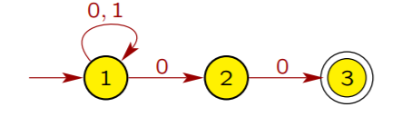
(III) Given L₁ = {a^{n}b| n >0} L₂ ={ab,ba}
(i) Give acceptor for L₁ intersection L₂
(ii) Give acceptor for L₁ - L₂
(IV) Given the automaton for the L
(ii) Give an automaton that accepts L^{R}
(iii) Give a automata that accepts
(V) Homework 2.1 exercises considered many languages. Make up problems similar to the problems described in #II.
Homework 4.1

